Slide 1
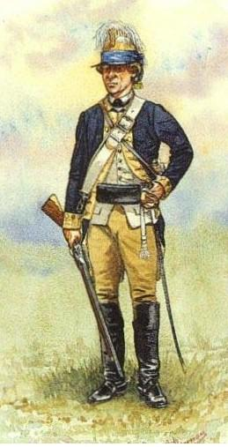
“Sheldon’s Horse” 2nd Regiment, Continental Light Dragoons
Connecticut’s Revolutionary War Cavalry
1776 - 1783
“Washington’s Eyes”
&
“Watchdogs of the Highlands”

Slide 2
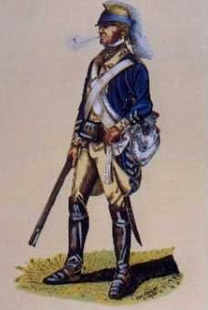
The first Congressional cavalry regiment in
the history of the
United States Army
as authorized by the
Continental Congress
and commissioned on
Dec. 12, 1776 by
Gen. George Washington.

Slide 3
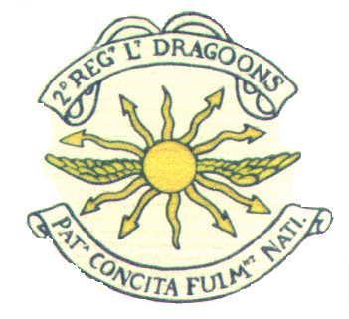
The nation calls, her sons respond in thunder tones

Slide 4
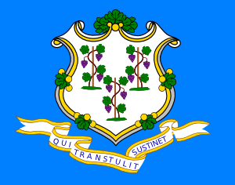
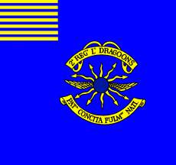
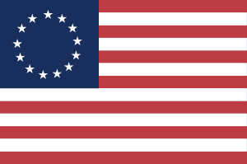
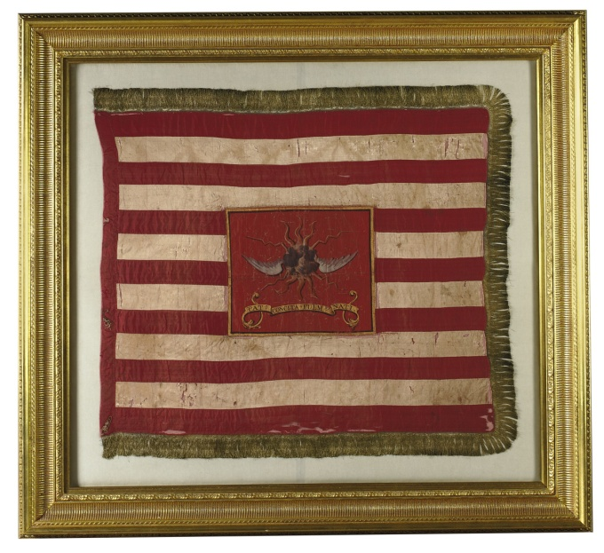
Flags under which “Sheldon’s” served.
Connecticut State Flag
Regimental Device
Regimental Flag
“Betsy Ross” Flag
“Tarleton-Bedford” Flag

Slide 5
Things in which the 2nd was 1st…
First commissioned cavalry in US history.
First “Pony Express”.
First cavalry charge on American soil at the
Battle of the Flocky.
First organized U.S. espionage system.
Achieved victories on foot, horseback and at sea
as whaleboat raiders capturing British vessels on
Long Island Sound.

Slide 6
Notable names
among the men of the
2nd Light Dragoons

Slide 7
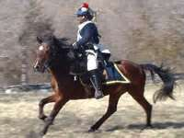
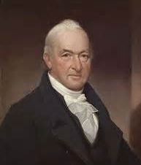
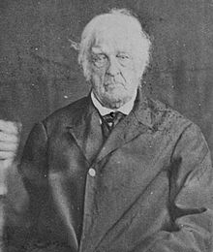
Col. Elisha Sheldon (1741-1805) – First Congressional Cavalry commander
Put his reputation and his personal liberty at risk to supply his men.
Survived the war and moved his family to what became Sheldon VT.
Maj. Benjamin Tallmadge (1754-1835) – Washington’s Spy
Master; Friend of Nathan Hale; Litchfield Town postmaster 1792; First
Treasurer of the Society of the Cincinnati; Secretary of the Society
of the Cincinnati; U.S. House of Representatives 1801-1817.
Capt. Thomas Youngs Seymour (1757-1811) – “Beau Sabreur of Saratoga”
Aide to Generals Gates and Arnold; Escorted Burgoyne to Boston;
Society of the Cincinnati; Lawyer & Connecticut legislator; Abolitionist;
Founder and Commander of the Connecticut Governor’s Horse Guard.
Sgt. Elijah Churchill (1755-1841) – Awarded Badge of Military
Merit by General Washington in 1782. In the ancestral line
of Winston Churchill.
Lemuel Cook (1759-1866) – The Last Man
Was 1 of 20 2LD assigned “On Command” to Washington. Present at Siege
Of Yorktown. Last survivor of the 2LD and last surviving Revolutionary War
veteran. One of seven Revolutionary War veterans to survive into age of
photography and featured in “The Last Men of the Revolution (1864).

Slide 8
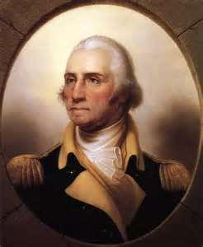
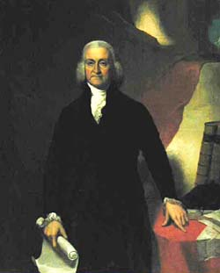
Creation of the American Dragoons
Colonel Elisha
Sheldon
No known image exists
Governor
Jonathan
Trumbull
His Excellency
General George Washington

Slide 9
Governor Jonathan Trumbull (1710 – 1785)
Royal Governor of the Crown
Colony of Connecticut.
(1769 -1776)
State Governor of Connecticut. (1776-1784)
Only Royal Governor to side with the rebellion and only colonial governor to remain in office throughout the war.
Had himself served as a state dragoon officer in 1732.

Slide 10
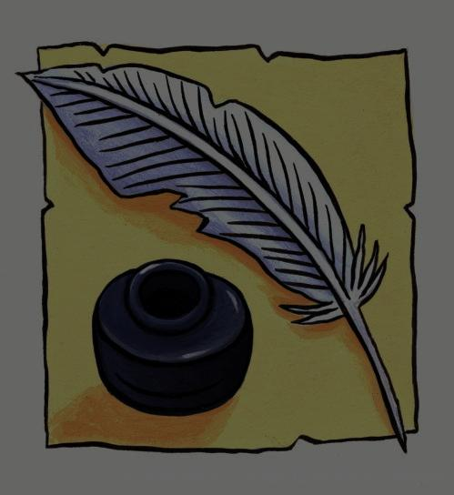
As governor, Trumbull was able to read the quill-writing on the wall; and so he…
Defied the Royal decree against manufacturing.
Authorized a cannon foundry in Salisbury, CT.
Began the manufacture of “Committee of Safety”
muskets, pistols, bayonets and munitions.
Established his War Office near the family
home in Lebanon, CT.
Divided Connecticut into 27 military districts,
each with a company of infantry, a train of
artillery and a troop of horse.

Slide 11
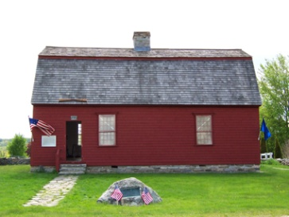
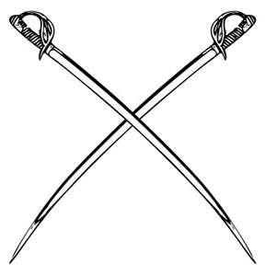
Gov. Trumbull’s
War Office
Lebanon Green,
Lebanon, CT

Slide 12
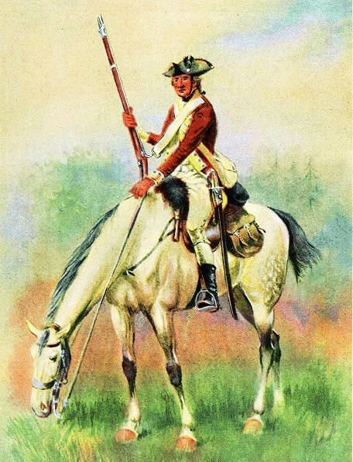
Governor Trumbull included
the 5th Connecticut Light
Horse Militia commanded
by Major Elisha Sheldon
as part of the state militia
contingent sent to
General Washington
in New York after the
Battle of White Plains.

Slide 13
General George Washington (1732-1799)
At first Washington didn’t see the need
for a mounted component to his army.
Changed his mind after the Battle of
White Plains.
Requested Congress to authorize a
mounted corps.
Assigned Major Elisha Sheldon of the
5th Connecticut Light Horse Militia the
task of creating a corps of cavalry on the
“Continental establishment”.
A 1778 British attempt to kidnap
Washington would fail because “The
2nd Dragoons are always with him.”

Slide 14
Colonel Elisha Sheldon (1741 – 1805)
Son of a Connecticut legislator.
Boyhood friend of Ethan Allen.
Served from 1768 as a captain in
a state light horse militia regiment.
Commissioned 12/12/1776 by
Washington as Colonel-Commandant
to raise a troop of Connecticut horse
on the “Continental establishment”.
Commanded the 2LD throughout
the war.

Slide 15
~Allies~
We didn’t win this on our own!

Slide 16
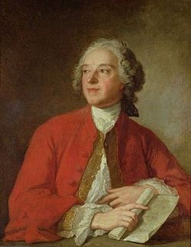
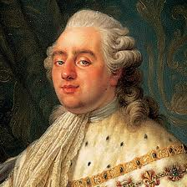
The European Connections
Vive la France!
What was I
thinking?
Pierre-Augustin Caron
deBeaumarchais
King Louis XVI
Composer, inventor and author
of the three “Figaro” plays, he
would be a driving force behind
Hortalez et cie, a joint Franco-
Spanish venture to smuggle war
materiél to the rebel colonists.
The French monarch’s decision
to aid the American rebels
would eventually sow the seeds
of his own destruction.

Slide 17
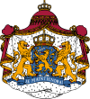
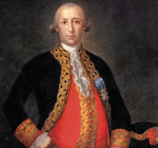
Vivá España!
Dutch Treat!
Bernardo de Galvez y Madrid
Viscount of Galvezton, Count of
Galvez and 61st Viceroy of New Spain.
He aided the 13 Colonies by shipping
supplies from Hortalez up the Mississippi
and by taking military action against the
British in the Floridas.
Dutch aid in the form of arms
and munitions was smuggled
to the Americans through the
Dutch island of St. Eustatius.

Slide 18
At this point you might be wondering:
Q: Just what is a Dragoon anyway?
A: A Dragoon is a soldier trained to fight on
foot as an infantryman and on horseback
as a cavalryman. What made a dragoon a
Light Dragoon was the stature of his mount.

Slide 19
Q: Why are dragoons called dragoons?
A: There are two speculative answers both
based upon the French word for dragon –
dragón:
1. A man on a horse wielding a fire-spitting tube appeared to be a dragon-like creature.
2. The flint-holding jaws of some more ornate muskets were cast as dragon heads.

Slide 20
Q: How many men served in the
2nd Dragoons during the war?
A: Although the 2nd never served as a whole, it was the largest of the four Congressional, or Regular dragoon regiments with a maximum roster of approximately 416 men (troopers), NCOs, officers and supernumeraries, although never more than 250 “effectives” at any one time. However, the overall size of the regiment is what permitted it to perform the myriad duties it would undertake during the conflict. Over 700 men would serve in the regiment during the course of the war.

Slide 21
Q: Why is it that the 1st commissioned
cavalry is designated as the 2nd Light
Dragoons?
A: Politics, politics, politics; location, location,
location.
Congress gave the honor of the designation
of being the 1st Dragoons to a Regiment from
Virginia.
However, Sheldon was with Washington in
New York when the commissions came through
and so the 2nd received its commission first.

Slide 22
Uniforms
And
Equipment

Slide 23
The clothes make the man…
Even before the 1777
American victory at
Saratoga, the 2LD had
begun to receive
uniforms and equipage
from France.
Brass helmet with horse
hair crest & blue turban
over bearskin (Or leather
helmet)
Black
cloth
neck
stock
Short regimental jacket, blue with white facings and cuffs
Carbine sling
White waistcoat
(worn over a cotton shirt)
Cartridge box
Charleville
carbine musket
Tan deerskin leather
riding breeches with
white cloth knee guards
Black leather
knee-high
riding boots
and spurs
Sword & bayonet in
double carriage

Slide 24
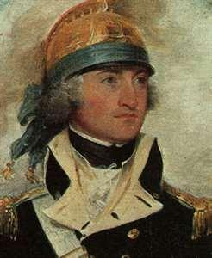
Capt. Thomas Youngs Seymour models the brass dragoon helmet for your edification…
Brass helmets afford greater
protection against sword blows.
Raised center crest acts as does a
“crumple zone” on a modern
motor vehicle.
Horse hair crest denotes cavalry and
is a protective element – the horse hair
is slick and hard to cut, thus shedding
sword strikes off the back of the head.
“Thomas Youngs Seymour”
– Artist: John Trumbull
ca. 1793
Helmet has an internal suspension
system, precursor to modern military
and sports helmets.

Slide 25
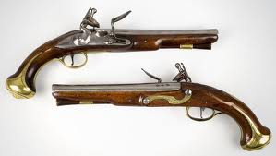
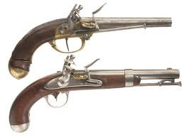
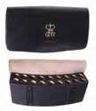
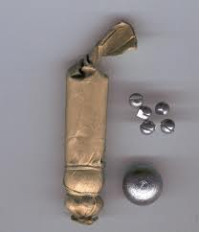
The tools of the dragoon…
Flintlock carbine musket
Bayonet
Blunderbuss
Pistols
Pistols
British style
French Style
Cartridge box & cartridges
Sword (or sabre)

Slide 26
And T E E T H !
Because you can’t bite the top off the
without opposable
teeth!

Slide 27
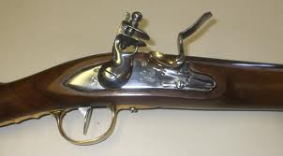
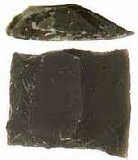
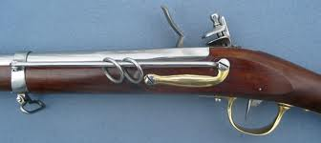
The firearms and how they function:
If they function
at all!
Carbine musket
The firearms shown are smooth-
bore black powder weapons with flint
and steel ignition.
Flint
Lock mechanism
Slide bar & ring
The slide bar and ring and a carbine sling as the original
“hands-free” device.
←Cartridge

Slide 28
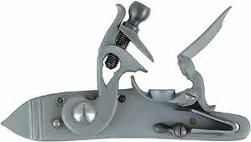
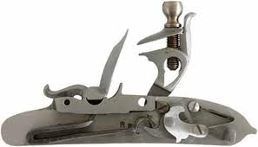
Musket Lock:
Front view
Gap aligns with touch
hole drilled through
barrel
Musket Lock:
Rear view

Slide 29
Boy, when things go wrong!
As if having a weapon that you can only load and fire, at
best, one time every 15-20 seconds isn’t bad enough…
18th Century firearms were an unreliable weapons system.
Black powder susceptible to weather – wet gun powder does not ignite.
Wind can blow priming charge out of priming pan.
Wind can blow sparks away from priming pan.
Subject to “flash in the pan”.
Powder supplies may be adulterated.
Flints may fail to spark.
Unhardened frizzens may fail to spark.
Firearms subject to delayed ignition or hang fire.
Subject to misfire.
Multiple loads may cause breech to blow out.

Slide 30
And then there are the swords!
18th Century steel
was brittle. Why?
High quality carbon steel requires temperatures
of 2,500-3,000° C and carbon (i.e. from charcoal)
plus constant working to remove the impurities
from the iron in order for the iron and carbon to be
blended to form the alloy we know as carbon steel.
The 18th Century swordsmith’s forges could not
achieve the temperatures necessary to fabricate
high quality carbon steel.

Slide 31
As a result, the blades of 18th Century swords
had blunted edges to discourage using the edge
of the blade, which might cause the blade to
snap. They were not cutting weapons.
Neither were they stabbing weapons when used
by cavalry, due to the inertia of motion.
When used by cavalry, swords were intended to
be used to inflict blunt force trauma injuries.
Nevertheless, a dragoon without his sword is just
one thing –
A dead man riding!

Slide 32
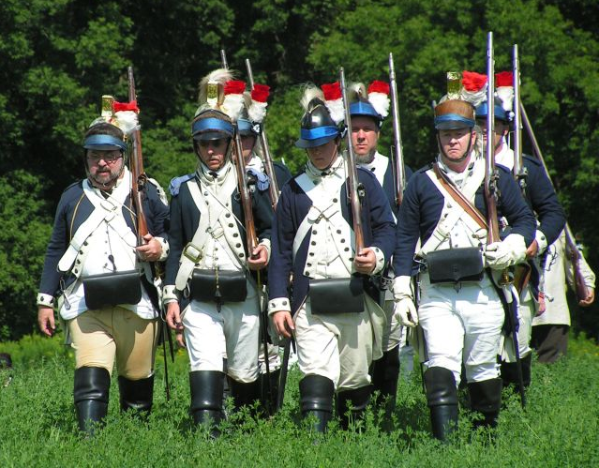
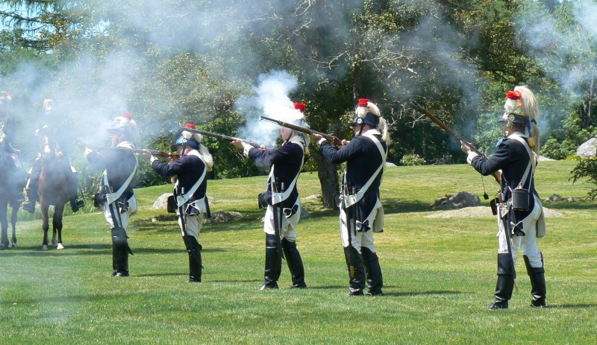
Once equipped the soldiers train to march and fight, first as dismounted troops…
In tight formations as
a battalion company…
In open order
as skirmishers...

Slide 33
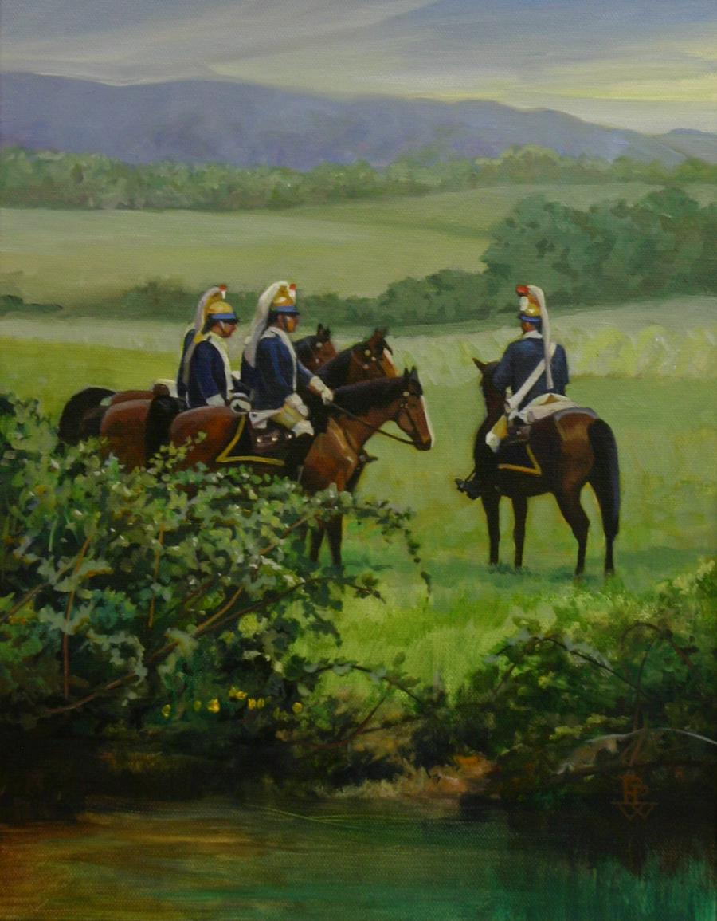
A mounted dragoon needs a horse, of course…
“On Patrol”
by Pamela Patrick White

Slide 34
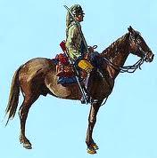
The Mounted Dragoon…
A boy and his horse
Portmanteau,
bedroll and
saddle bags
Sword
Everything the trooper
needs to do his job:
training, patrolling and
combat, is mounted to the
front or to his side.
Cartridge box
Pistol
holsters
Carbine
(slung)
Those things unnecessary
to those tasks are mounted
behind the trooper.
Horse

Slide 35
And speaking of horses, did you know that a horse has a 6-foot blind spot directly to its front?
Yes, it’s true!
Horses are prey animals – their eyes
are set to the side for greater peripheral vision, and
don’t reach a point of focus until 6 feet to their front.
Humans are predators. Predator’s eyes are set to the
front, allowing for stereoscopic vision, depth
perception and focus.
A human on horseback creates a situation, highly unusual in nature, of a predator animal and a prey animal working in unison.

Slide 36
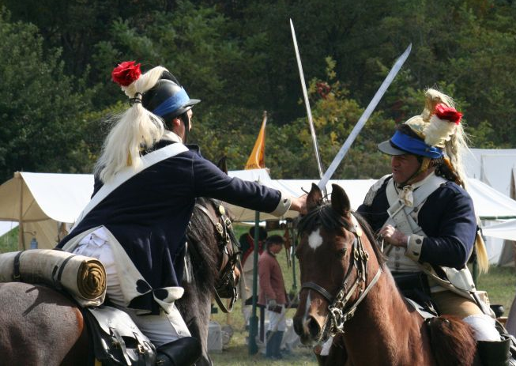
Horse and rider train…
With the hay head…
…and hand-to-hand
sword training.

Slide 37
Mounted and dismounted elements train together

Slide 38
CALL TO ACTION!
~ or ~
All dressed up with
someplace to go!

Slide 39
Q: What type of functions did the
2nd Dragoons perform?
A: Recruiting and training; patrolling and
intelligence gathering; messenger service;
guarding supplies, commissaries and supply
routes; flanking, screening and skirmishing;
combat and ambuscades; espionage;
guarding Washington and serving on his staff.

Slide 40
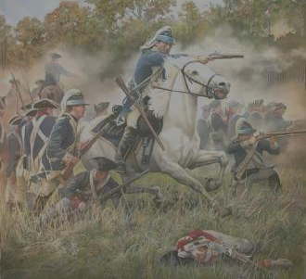
Q: What battle service did the 2LD see?
A: 12/26/1776: Battle of Trenton(NJ)
1/2/1777: 2nd Battle of Trenton (NJ)
1/3/1777: Battle of Princeton (NJ)
4/27/1777: Battle of Ridgefield (CT)
6/24/1777: Battle of Woodbridge (NJ)
6/28/1777: Battle of Short Hills (NJ)
8/13/1777: Battle of the Flockey (NY)
9/11/1777: Battle of Brandywine (PA)
9/19 – 10/17/1777: Battles of Saratoga (NY)
10/4/1777: Battle of Germantown (PA)
12/7 – 12/8/1777: Battle of Whitemarsh (PA)
12/--/1777: “Rawdon’s action (PA)
12/--/1777: The Rising Sun Tavern action (PA)

Slide 41
1/21/1778: Valley Forge skirmish (PA)
6/28/1778: Battle of Monmouth (NJ)
10/7/1778: Clap’s Tavern Road (now King Street) (NY)
7/2/1779: Burning of Bedford/Battle of Pound Ridge (NY)
7/11/1779: Battle of Norwalk (Tryon’s Raid) (CT)
8/5/1779: Morrisania (NY)
8/29/1779: Battle of Newtown (NY)
9/5/1779: Raid on Lloyd’s Neck (LI, NY)
11/23/1780: Raid on Fort St. George (LI, NY)
11/23/1780: Raid on Corum (LI, NY)
7/2/1781: Ft. Knyphausen (NY)
7/15/1781: Tarrytown (NY)
9/28 – 10/19/1781: The Siege of Yorktown (VA)
10/3/1781: Ft. Salongo (LI, NY)
12/7/1782: Norwalk Islands naval action (CT)
1/??/1783: Capture of the “Shuldham” in Norwalk (CT)
2/20/1783: Capture of the “Nancy” at Stratford Pt. (CT)

Slide 42
1779 – It was a very big year!
It was the year the Connecticut coast went up in flames…
It was the year the British went Dragoon hunting…
It was the year the Americans went Indian hunting…

Slide 43
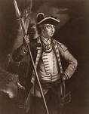
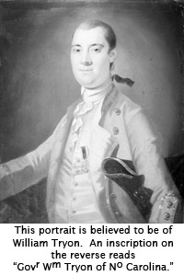
In response to Indian depredations in
the Wyoming, Cherry & Mohawk Valleys,
Washington dispatches Sullivan with a force
sufficient to burn out the villages of the
Iroquois Confederation in northern PA
and southern NY. Sullivan’s Expedition
included 40+ Sheldon’s Dragoons which
merged into Spencer’s
Division.
Gen. John Sullivan
William Tryon, Royal Governor of the
Colonies of New York and North Carolina
visited destruction on the Connecticut Coast
during the summer of 1779 in retaliation for
the cross-sound raiding rebels; East-and-West
Haven on July 5th and Fairfield on July 6th,
burning homes, shops and churches.
Gov. William Tryon

Slide 44
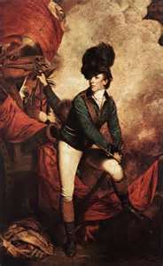
Meanwhile, on the rainy evening of July 9th
Banastre “Bloody Ban” Tarleton led his Tarleton’s
Legion into the small town of Bedford, NY. His
troops overwhelmed the 2LD, pushing them out
of Bedford to the hamlet of Pound Ridge where
2LD and local militia offered stiff resistance.
Nevertheless, Tarleton captured the 2LD HQ,
baggage and flags before heading back to New York
City. Only rain prevented them from burning the town.
Col. Banastre
Tarleton
This flag is one of four
battle flags that Tarleton
took when he returned to
England. His great ++
grand nephew sold it at
auction at Sotheby’s NYC
for $12.6 million dollars on
Flag Day, June 14, 2006.
Modern 2LD
Honor Guard at
flag auction.

Slide 45
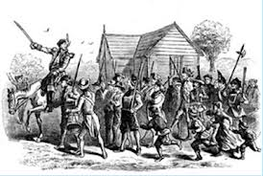
He-e’s ba-a-a-ck!
On the 11th of July, 1779, Royal
Governor William Tryon returns
to turn his not-so-tender mercies
on Norwalk. He lands Loyalist and
Hessian forces who inflict severe
damage.
The Burning of Norwalk
Despite inflicting severe damage
to property, the raid on Norwalk
failed to have any significant
impact on the ability of the
Norwalk commissary to
supply rebel forces in this area.

Slide 46
Be very, very quiet;
we’re hunting…

Slide 47
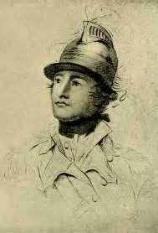
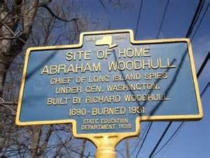
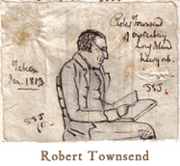
S P I E S!
Col. Benjamin
Tallmadge, 2LD –
Headed “Culper “
Spy Ring from
1778.
Gen. George
Washington –
America’s first
spy master.
Abraham
Woodhull –
“Culper, Sr.”
operated on
Long Island,
while…
Robert
Townsend –
“Culper, Jr.”
operated in
and around
New York City.

Slide 48
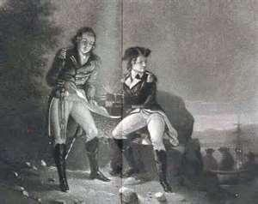
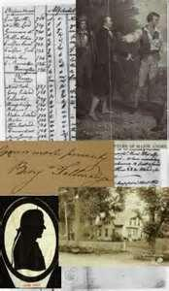
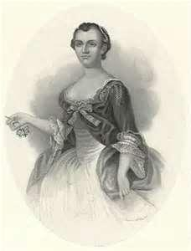
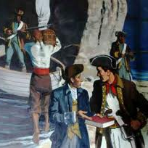
Information
passed in
code or by
messages
written in
invisible ink...
Spies gathered
information on
LI & in NYC...
Female agents
such as
Anna Strong
then sent coded
information,
perhaps via
hanging
laundry for…
Capt. Caleb
Brewster – spy,
whaleboat-man
& privateer.

Slide 49
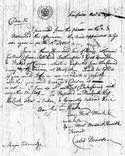
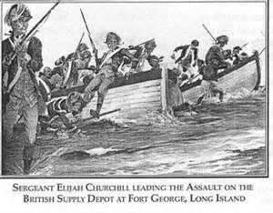
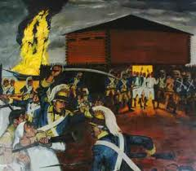
Brewster would
then transmit
the intelligence
back to…
…Tallmadge
who would
organize…
…destroy
British
supplies
and
fortifications.
…raids
on LI
to…

Slide 50
It was for actions on one such
Long Island raid that Sgt. Elijah
Churchill of the 2LD was awarded
The Badge of Military Merit,
forerunner to the modern
Congressional Medal of Honor.
“First Honors”
by Pamela Patrick White
The presentation
was made by
Gen. Washington
on 7 August, 1782.
Three Badges are known
to have been awarded, all
to men from Connecticut.

Slide 51
And where there are spies, there is…

Slide 52
TREASON! The Arnold – André Affair
General Sir Henry Clinton –
British commander in North America
garrisoned in the City of Philadelphia
and later in New York City.
Major John André –
Aide to General Clinton, Clinton’s party planner and close friend of Miss Peggy Shippen, later to be Mrs. Benedict Arnold.

Slide 53
Miss Peggy Shippen –
Daughter of a well-to-do Loyalist
Philadelphia family. She would catch
the eye of Benedict Arnold who would
woo and wed her.
General Benedict Arnold –
Perhaps the finest general in General
Washington’s army, but a flawed man
whose vanity and spite would lead him to try and sell the plans of West Point to the British army.

Slide 54
Andre was captured
near Tarrytown on
his way back to NYC
with the plans to
West Point in his
boot.
He was turned
over to Col. John Jameson of the 2LD and
brought to
Tappan NY
for trial.
Officer’s of the 2LD comprised
part of Andre’s trial board. He
was found guilty and executed.
His place of incarceration is now a
popular restaurant in Old Tappan, NY.

Slide 55
The World Turned Upside Down!

Slide 56
The British defeat at Yorktown at the
hands of the Franco-American Army
stunned the world.
Legend has it the British Field Music played
“The World Turned Upside Down” as the
English Army and its mercenary allies
laid down their arms in October of 1781.
Although some actions on the Western Frontier
were still to be fought, hostilities east of the
Alleghany's came to an end.

Slide 57
Although the regiment had been furloughed on
June 9th, in July 1783 Washington toured the
devastated Mohawk Valley accompanied by a
troop of 2nd Dragoons.

Slide 58
The regiment was decommissioned on November 20th, 1783.
“Washington’s Farewell”
Artist: Alonzo Chappell
ca. 1866
On November 25th, 1783,
Washington held a dinner
in New York City at
Fraunce’s Tavern to bid
farewell to his officers, among them officers of the 2LD.
Battle hardened veterans wept unashamedly.

Slide 59
Afterward, Washington led the parade following
the British to the ships waiting to take them home.
“Evacuation Day”
– Lithographers: E.P. & L. Restein
ca. 1789

Slide 60
The British boarded their waiting vessels
and sailed out of New York Harbor...
…and the next phase of the great
American Experiment
could now begin.

Slide 61
In the aftermath of the War, lands previously held by
the Indigenous population or by the Crown came into
American hands. The Western Reserve and the Firelands
were opened for settlement and Western Expansion, the
first steps of what would be called Manifest Destiny
were taken.
“Sheldon’s” veterans participated in that westward
migration and graves of 2LD veterans have been located as far west as Michigan and as far south as Alabama.
While some returned to their farms, former trades or
professions, others became legislators, judges or served in other prominent capacities. Proud of their dragoon service, many had their regimental information carved into their gravestones.

Slide 62
And now,
the 2nd Dragoons
in historical art...

Slide 63
“Washington Before
The Battle of Trenton”
– Artist: John Trumbull
ca. 1792

Slide 64
“Surrender of General Burgoyne at Saratoga “
– Artist: John Trumbull ca. 1821

Slide 65
“Washington at Yorktown”
– Artist: Constantino Brumidi
ca. 1781

Slide 66
“An eye-witness sketch of
a private in the 2nd Continental
Light Dragoons during the
Yorktown Campaign, from
the journal of Sub-Lieutenant
Jean-Baptiste de Verges of the
Royal Deux-Ponts Regiment
in Rochambeau’s French Army.”
Excerpted from “The United
States Cavalry, An Illustrated
History” by G. J. W. Urwin.

Slide 67
Sometimes life imitates art…
Nielson
farmhouse
Saratoga Battlefield
Saratoga NPS

Slide 68
Fun Facts!
Keep your powder dry
Flash in the pan
Don’t go off half-cocked
Lock, stock and barrel
Cross my heart and hope to die
Flip your wig
These are all expressions that come from
Revolutionary times, or earlier.
However, no one ever said “Don’t fire until you see the whites of their eyes,” anywhere, except in Pastor Weems book of American fables.

Slide 69
Everything olde
is new again!

Slide 70
“Sheldon’s Horse” today…
Reestablished in 1978 during the Bi-Centennial of the American Revolution.
We are a §501 (c) 3 Not-for-profit volunteer organization.
We are recognized by proclamation of the 106th United States Congress as the inheritors of the original 2nd Dragoons.
We are officially recognized historical representatives of the States of Connecticut, Rhode Island and Massachusetts.
We are members of: Centennial Legion of Historic Commands, The Brigade of the American Revolution, The Continental Line, The Living History Association, The Burning of the Valleys Military Association.

Slide 71
Membership in today’s 2LD
Active membership, individual or family: If you are between
the ages of 21 and 75, have a love of history and are willing
to put in the time and expense, we are always looking for
dedicated individuals to swell the ranks of both our mounted
and dismounted squads. Young adults 18 or over may carry
weapons only under the supervision of a participating male
family member.
Heritage Membership: Did you have a Revolutionary War
ancestor who served in the 2nd Dragoons between 1776 and
1783? If you do and have the requisite genealogical proof,
you automatically qualify for a Heritage membership.
Or both!

Slide 72
What does the 2LD do today?
We
educate…
We
demonstrate…

Slide 73
We
commemorate…
We
celebrate…

Slide 74
Some events we re-create…
Cavalry charge at The Battle of the Flockey

Slide 75
Donors we
appreciate…
And we work exclusively
with rescued
horses.

Slide 76
Plus…
We have Fun!

Slide 77
Suggested reading and viewing:
“Washington’s Eyes –
The Continental Light Dragoons”
by Burt Garfield Loescher
“Soldiering On With the Third Troop,
Second Continental Light Dragoons,
1782-1783”
Edited and annotated by Salvatore Tarantino
and John T. Hayes

Slide 78
“Washington’s Spies – The Story of
America’s First Spy Ring”
by Alexander Rose
“Connecticut’s Revolutionary
Cavalry: Sheldon’s Horse”
by John T. Hayes

Slide 79
“A Substantial Yeomanry:
The Connecticut Light Horse
1776-1783”
by John T. Hayes
“The United States Cavalry
An Illustrated History”
by Gregory J.W. Urwin
Illustrated by Ernst Lisle Reedstrom

Slide 80
“Memoir of Col.
Benjamin Tallmadge”
by Benjamin Tallmadge

Slide 81
“The Scarlet Coat”
MGM Studios – 1955
was based upon the
Arnold/Andre Affair.
Cornel Wilde portrays
Major John Bolton of
the Connecticut Light
Horse. John Bolton
was Tallmadge’s code
name within the
“Culper” Spy ring.

Slide 82
For further information…
For general, schedule or booking
information, or to make a donation, visit our website at www.dragoons.info
or contact:
Capt. Sal Tarantino
192 Prospect Hill Rd.
Colchester, CT 06415-1620
(860) 537-1761
sh2ldhq@erols.com
Lt. Eric Chandler
101 Ledgebrook Drive
Norwalk, CT 06854-1069
(203) 838-7764
echandler1073@yahoo.com

Slide 83
~ The End ~
Created by Eric M. Chandler
March, 2013
A Dunnwerkin Production

